Slide 1
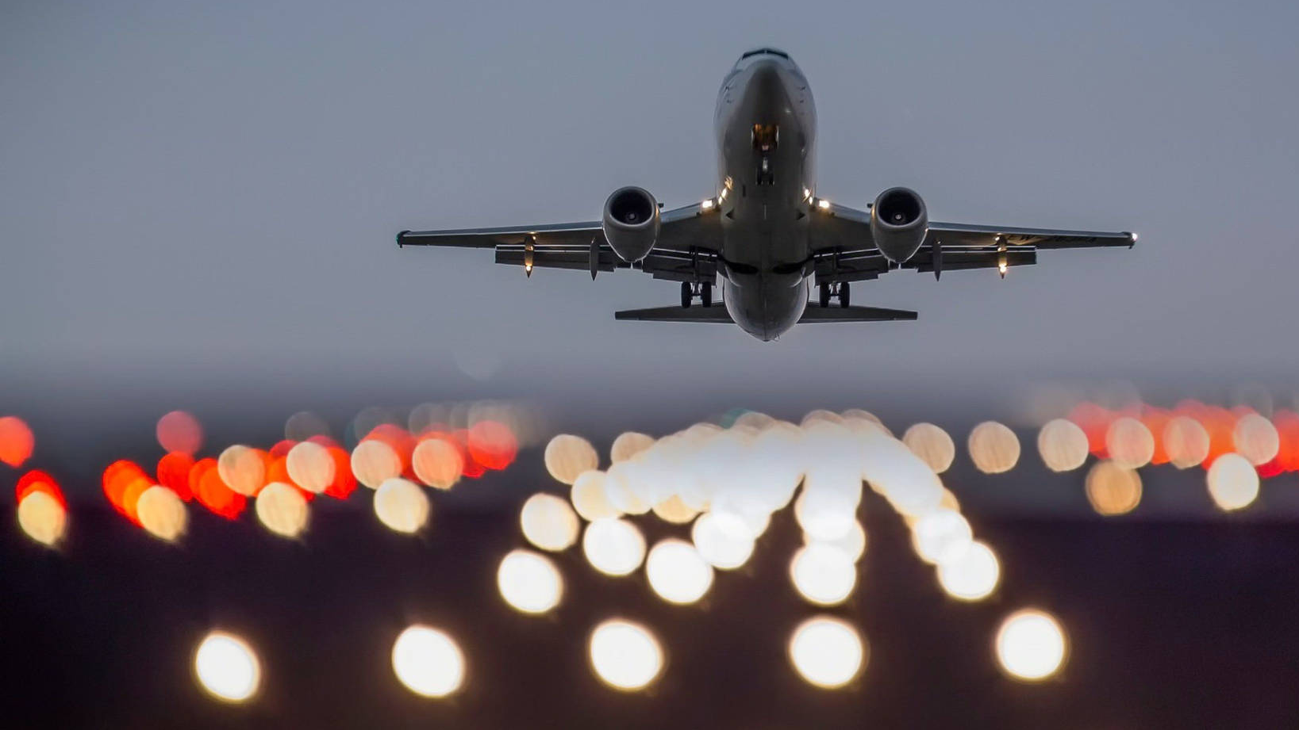
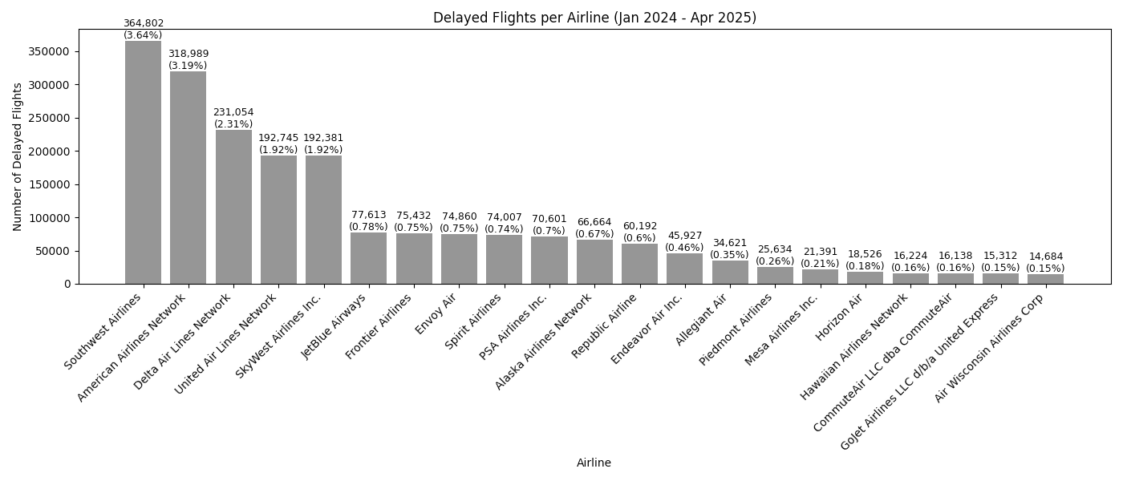
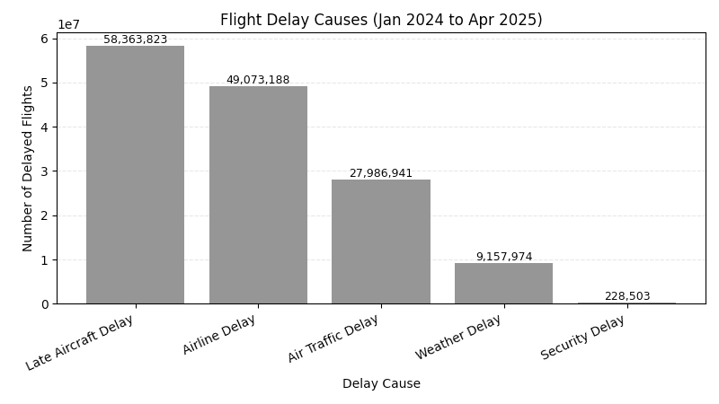
Flight Delay Tracker
Top Delay Reasons
Tracking and visualizing U.S. airline delay patterns using real data and Python tools
I analyzed over 10 million flights using a dataset pulled from the Bureau of Transportation Statistics. This project uses Python and pandas to clean and visualize flight delays across major U.S. carriers. The results highlight late aircraft and air traffic as the most common delay causes.
Delays by Airline
Team: Israel Munguia-Benitez

